Slide 1
A FAST NEAREST NEIGHBOUR SEARCH SCHEME OVER OUTSOURCED ENCRYPTED MEDICAL IMAGES
Submitted by
Monica M(20139112)
Suriya V(20139126)
Dinesh S(20139106)

Slide 2
Abstract
Medical imaging is crucial for medical diagnosis, and the sensitive nature of medical images necessitates rigorous security and privacy solutions to be in place. In the paper, we propose a secure and efficient scheme to find the exact nearest neighbour over encrypted medical images. Unlike most existing schemes, our scheme can obtain the exact nearest neighbour rather than an approximate result. our proposed scheme obviously meets the security requirements. It protects the secrecy and privacy of data as well as the user’s input query while simultaneously hiding data access patterns. Our scheme is designed to ensure the confidentiality of all related medical images. To ensure query privacy, the database and query need to be encrypted before sending to the cloud server. Proposed Homomorphic algorithm is used to encrypt data images. the best method is Advanced Encryption Standard method (AES). There are many types of AES that can be used but the most effective is AES-128. So, the aim of this study is to design image cryptographic application using the AES-128 method. Process of design applications with this method is through several stages, such as process of encryption, decryption, key generation and testing of the methods used. The attacks test is given by cropping, blurring, and enhancing the ciphertext image. To reduce the storage problem in Cloud we have split the image and file into different block and get stored, so storage problem get rectified . The proposed scheme needs to reduce the computation cost on the end-user as much as possible.

Slide 3
Existing System
There are a number of efficient schemes to find the approximate nearest neighbour, designed to improve efficiency in space and time at the cost of accuracy. The scheme based on Locality Sensitive Hashing (LSH) is a well-known and effective method that solves the nearest neighbour query problem in high-dimensional space. The LSH scheme [20] embeds data in low-dimensional subspaces and utilizes hash tables to improve efficiency. e most existing algorithms, this method can obtain the exact nearest neighbour rather than an approximate one. The beauty of this method is simplicity, in the sense of simple pre-processing without involving complex data structures. The g techniques have limitations and are not applicable to the healthcare industry’s medical imaging problem. These schemes, which are based on special data structures can reduce the search time cost because of the tree-structured organization of data. However, such data structures require large pre-process time and memory space, and so they are not appropriate for high-dimensional and large-scale data.

Slide 4
Proposed System
We propose a secure and efficient scheme to find the exact nearest neighbour over encrypted medical images. Instead of calculating the Euclidean distance, we reject candidates by computing the lower bound of Euclidean distance that is related to the mean and standard deviation of data. proposed an efficient scheme for k-nearest neighbour search, which enhances the protection of the decryption key and reduces the burden on data owners. t the algorithm proposed by Ahn et al. can simultaneously ensure both efficiency and accuracy. Based on this algorithm, we present an efficient scheme. our proposed scheme obviously meets the security requirements. It protects the secrecy and privacy of data as well as the user’s input query while simultaneously hiding data access patterns. the best method is Advanced Encryption Standard method (AES). There are many types of AES that can be used but the most effective is AES-128. So, the aim of this study is to design image cryptographic application using the AES-128 method. it was found that this method is resistant to cropping attacks, but not resistant to blurring and enhancement attacks. Improve the efficiency if image storage function.

Slide 5
Tools Used
Hardware Requirements:
System – Pentium IV 2.4 GHz.
Hard disk – 40 GB.
Floppy driver – 1.44 Mb.
Monitor – 15 VGA colour.
Mouse – DELL
RAM – 512 Mb.
Software Requirements:
Operating System – Windows XP/7.
Coding Language – Java
Front End – Html/css.
Back End – J2se, J2ee.
Database – Mysql
Tools – NetBeans IDE 7.2.1

Slide 6
Modules
Design Goals
Security Guarantee
Advanced Encryption Standard(AES)
Scalability
Block Storage
Waterfall Model
V-Model

Slide 7
Sample Screenshots

Slide 8
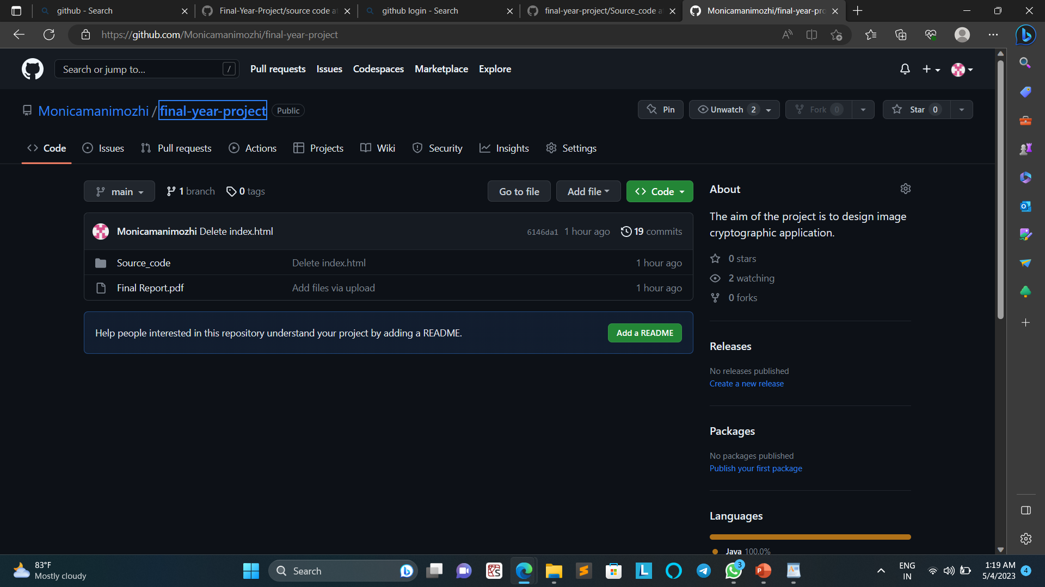
Github Screenshot

